Slide 1
Amylase
production

Slide 2
EC1 Oxidoreductases: catalyze oxidation/reduction reactions.
EC2 Transferases: transfer a functional group.
EC3 Hydrolases: catalyze the hydrolysis of various bonds.
EC4 Lyases: cleave various bonds by means other than hydrolysis and oxidation.
EC5 Isomerases: catalyze isomerization changes within a single molecule.
EC6 Ligases: join two molecules with covalent bonds.

Slide 3
Amylases
α-amylase (EC3.2.1.1)
Extracellular enzymes that randomly cleave the 1,4-a-D-glucosidic linkages between adjacent glucose units in the linear amylose chain.
Classified according to their action and properties.
‘saccharogenic’ amylases – produce free sugars
‘starch-liquefying’ amylases-liquefy starch without producing free sugars
Aspergillus sp. and Bacillus sp., mainly Bacillus amyloliquefaciens and B. licheniformis

Slide 4
β-Amylase
Is of plant origin, a few microbial strains
An exo-acting enzyme - cleaves non-reducing chain ends of amylose, amylopectin and glycogen molecules.
It hydrolyses alternate glycosidic linkages, yielding maltose
Unable to by-pass a-1,6-glycosidic linkages in amylopectin - results in incomplete degradation of the molecule
Bacillus, Pseudomonas (aerobic) and Clostridium (anaerobic) sp., Streptomyces sp., Rhizopus sp.

Slide 5
Glucoamylase
hydrolyses single glucose units from the non-reducing ends of amylose and amylopectin in a stepwise manner.
Aspergillus niger, A. terrus, Rhizopus sp., Clostridium, S. cerevisiae

Slide 6
Amylase production
Carbon source:
Submerged Fermentation:
Cheese whey, corn steep liquor and soya bean meal, lactose, dextran, soluble starch, glucose, maltose and xylose
Solid state fermentation:
Beet pulp, corn cob, tapioca, potato, rice husk, rice bran, wheat bran, maize bran, wheat straw and oil cakes

Slide 7
Amylase production
Nitrogen source:
Organic :
yeast extract, tryptone, beef extract, peptone, casein, urea, soy flour, glycin, L-lysin, L-tryosine, L-cysteine, glutamic acid, L-alanine, L-phenylalanine, L-isoleusine, L-valine and L-methionine
Inorganic :
ammonium nitrate, ammonium chloride, ammonium sulphate, and sodium nitrate

Slide 8
Amylase production
Metal ions
FeSO₄, MgSO₄, CaCl₂, CuSO₄ and ZnSO₄
pH:
Bacteria: 7.0
Fungi: 5-6
Temperature :25ºC to 37ºC

Slide 9
Amylase production
Solid state fermentation:
Raw substrates
Dried and moisture content is adjusted
Other nutrients are also added
Sterilized
Inoculated
Incubated with occasional mixing

Slide 10
Amylase production
Purification:
Strongly depend on the market, processing cost, final quality, and available technology
Mostly purified by chromatographic techniques after crude isolation by precipitation and membrane separations
need for large-scale cost effective purification
Evolution of techniques - fast, efficient and economical with fewer processing steps

Slide 11
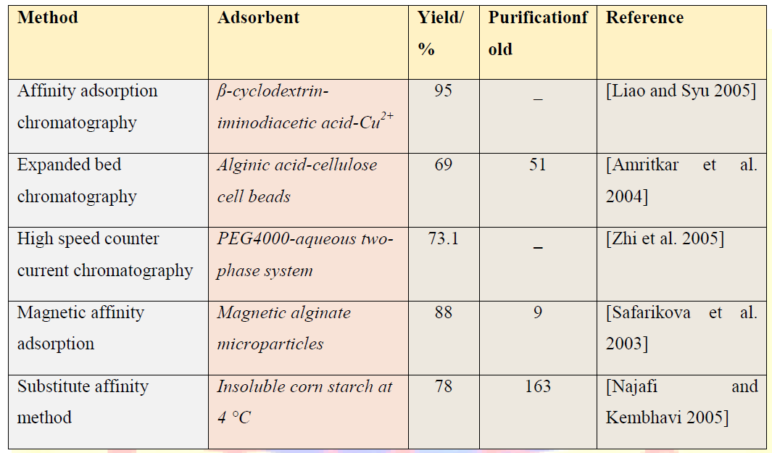
Purification methods for Amylase

Slide 12
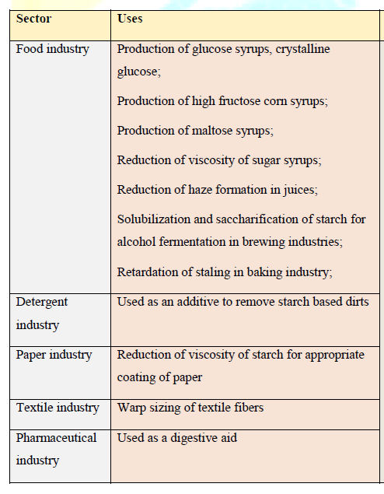
Applications of Amylase

